Slide 1
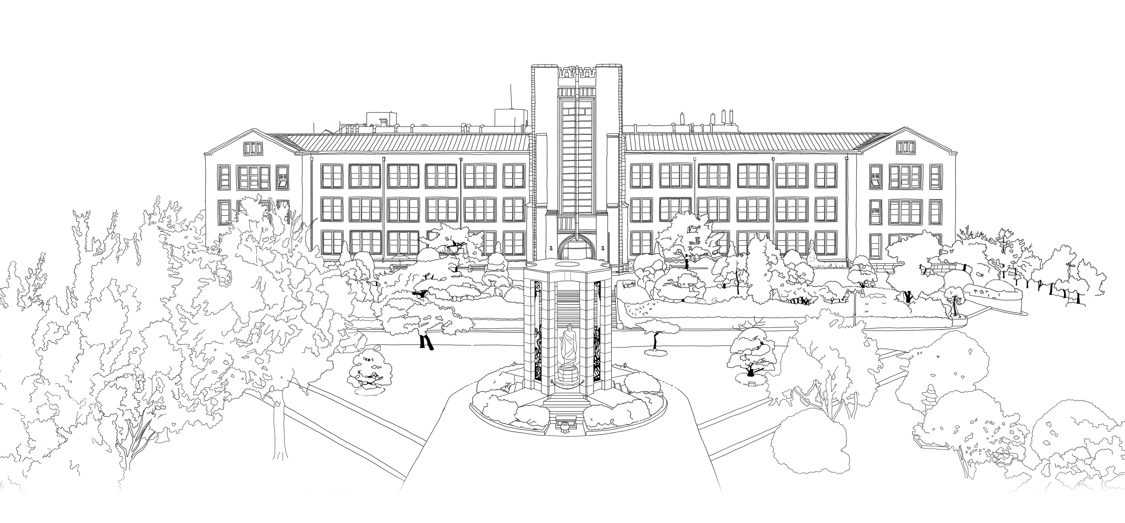


Uniformly Fine-Grained Data-Parallel Computing for Machine Learning Algorithms
DongYeon Kim
Department of Multimedia Engineering
Dongguk University

Slide 2
Contents
Introduction
Overview of a GP-GPU
Uniformly Fine-Grained Data-Parallel Computing on a GPU
Data-Parallel Computation
Uniformly Fine-Grained Data-Parallel Design
The k-Means Clustering Algorithm
k-Means Clustering
Uniformly Fine-Grained Data Parallelism in k-means
The k-Means Regression Clustering Algorithm
k-Means Regression Clustering
Fine-Grained Data-Parallel Structures in k-means RC on a GPU
Implementations and Performance Comparisons
CPU-Only Implementation of k-means
GPU-Accelerated k-means & k-means RC Algorithm
Conclusion

Slide 3
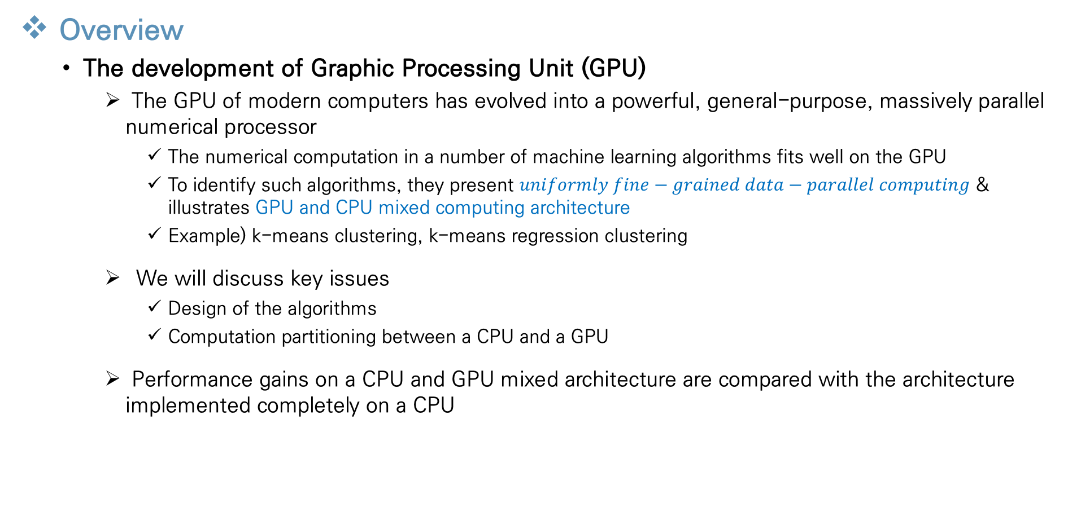
Introduction
Overview
The development of Graphic Processing Unit (GPU)
The GPU of modern computers has evolved into a powerful, general-purpose, massively parallel numerical processor
The numerical computation in a number of machine learning algorithms fits well on the GPU
To identify such algorithms, they present $uniformly fine−grained data−parallel computing$ & illustrates GPU and CPU mixed computing architecture
Example) k-means clustering, k-means regression clustering
We will discuss key issues
Design of the algorithms
Computation partitioning between a CPU and a GPU
Performance gains on a CPU and GPU mixed architecture are compared with the architecture implemented completely on a CPU
Notes:
먼저 이 챕터의 전반적인 내용에 대해 설명드리겠습니다

Slide 4
Introduction
Development CPU
The development of CPU
The computing power of the CPU has increased a lot in the past few decades
Physical limit of the CPU change the industry to go in the direction of packing multiple CPU cores onto the same silicon die
Parallel computing emerged from an optional computational architecture into a mainstream choice for general computing
As a result of this fundamental change in the computing architecture, algorithm design, data structure design and programming strategies have to be changed
Notes:
다음으로 cpu의 발전에 대한 설명

Slide 5
Introduction
GP-GPU
Original GPU
GPUs employed multicore parallel computing long before CPUs did
have special architecture because of the nature of graphics computations
some efforts were made to use GPU’s special architecture for more general-purpose numerical computing
Written code for the graphics interface was very unintuitive
Difficult to program general-purpose numerical algorithms on a GPU because of its specialized architecture
General-Purpose GPU (GP-GPU)
GPU has developed rapidly from a special GPU into a GP-GPU
GP-GPU has made the mapping of numerical computing task onto the new GPU architecture much easier
NVIDIA’s CUDA which is an augmented C interface is also available now for programming GPUs for generally-skilled programmers
Notes:
다음은 gpu에 대한 설명 입니다

Slide 6
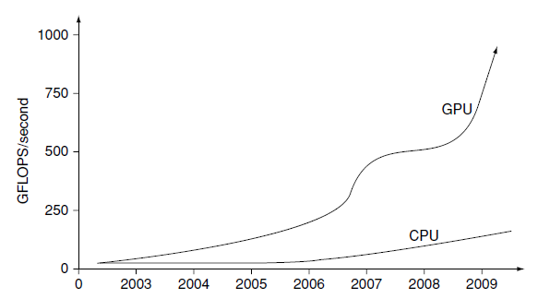
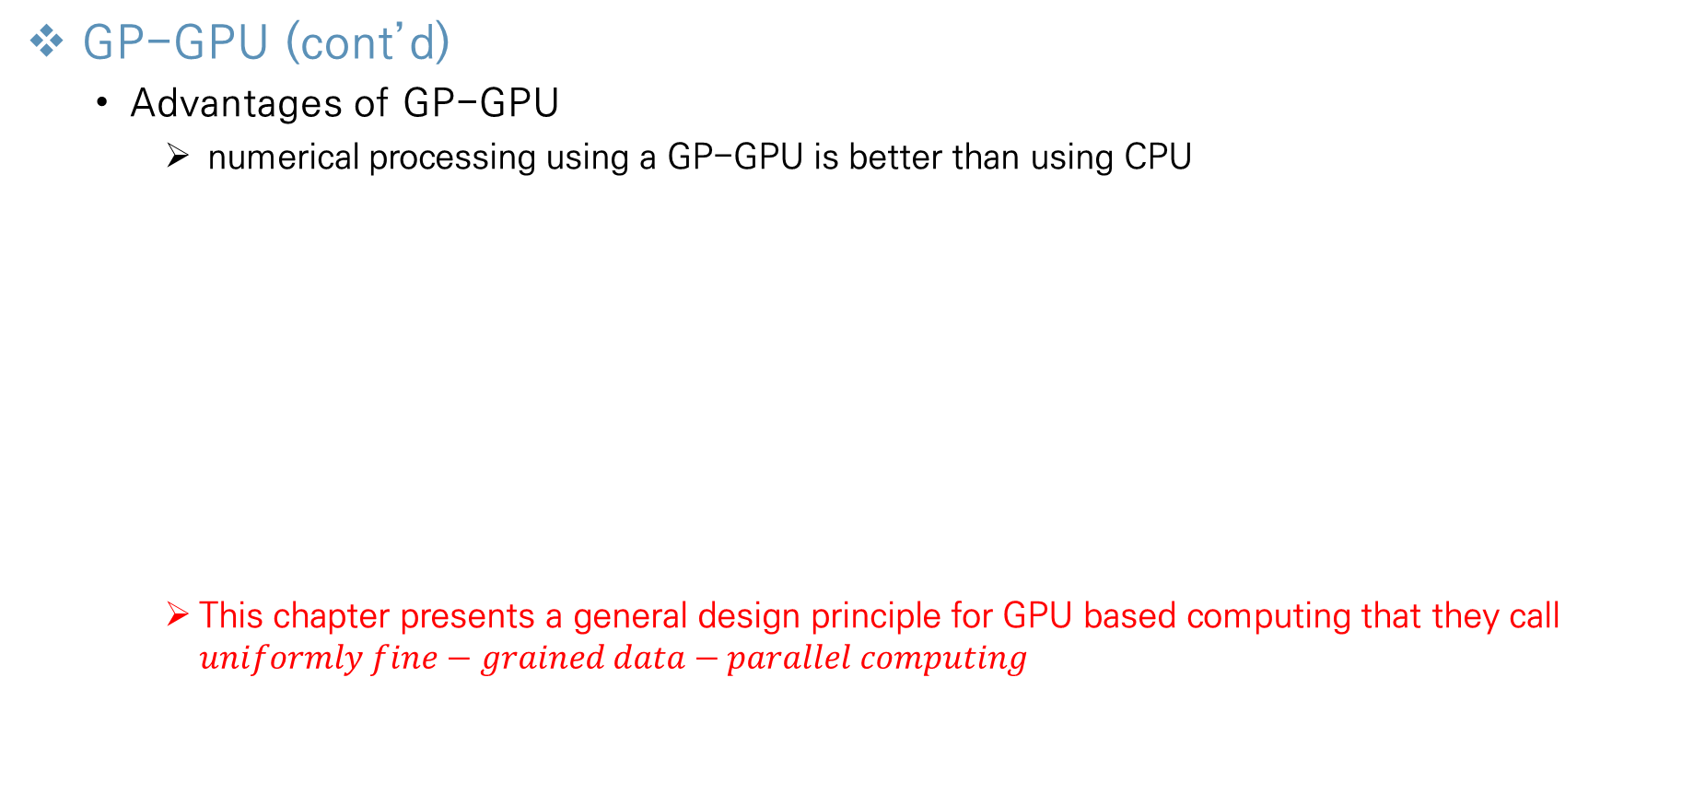
Introduction
GP-GPU (cont’d)
Advantages of GP-GPU
numerical processing using a GP-GPU is better than using CPU
This chapter presents a general design principle for GPU based computing that they call $uniformly fine−grained data−parallel computing$
Saving hardware cost
Saving power consumption per GFLOPS (Giga FLOating-point operation Per Second)
GPU use 300W of power and can solve numerical problems about 40 more times faster than CPU (at 50W)
The performance increase of a GPU and a CPU
Notes:
이러한 gp-gpu는 cpu대비 다음과 같은 장점을 가지고 있습니다
따라서 이 챕터에서는 GPU 기반 컴퓨팅을 하기위한 일반적인 디자인 방법을 설명하고, 이를 uniformly fine-grained data-parallel computing 이라고 한다.

Slide 7
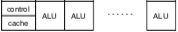
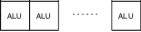
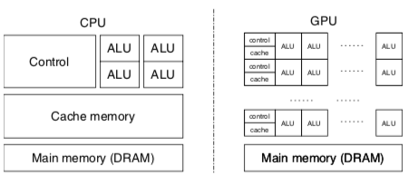
Overview of a GP-GPU
The structure of GP-GPU
Multiple multiprocessor
A GPU consists of a two-level hierarchical architecture
Multiprocessor has multiple lightweight data-parallel cores
multiprocessor sharing the same program logic
Shared memory (Cache)
Shared by the cores within the same multiprocessor
Low access-latency
Global memory (Main memory)
Shared by the cores in different multiprocessor
Much longer access latency than the cache
The structure of CPU & GPU
Notes:
알고리즘을 병렬화하여 진행하기 위해 수정하려면 ,gpu의 구조를 알아야 하기 때문에 전체적인 gpu의 구조에 대한 설명이 필요하다

Slide 8
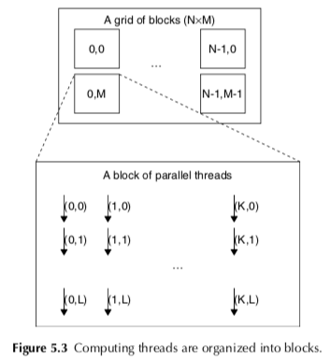
Overview of a GP-GPU
The structure of GP-GPU (cont’d)
Grid, Block and Thread
Thread
The thread is the execution unit of the process
Computing threads on a GPU are organized into thread blocks
Each thread up to three dimensional indices (Thread ID)
Block
Many thread blocks are organized into a thread grid
Each block has indices (Block ID)
Grid
Unit of launch for execution
Enough thread blocks are necessary to keep all the multiprocessor busy
Threads are linked to data for data-parallel by mapping the block & thread ID to data indices
Notes:
Gpu에서 프로그램이 실행될때 형성되는 구조인 그리드, 블록, 스레드에 대한 설명

Slide 9
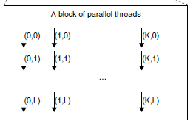
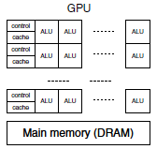
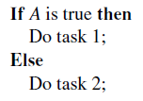
Overview of a GP-GPU
The structure of GP-GPU (cont’d)
Thread Block & GPU
The threads within the same block are always executed on the same multiprocessor throughout their lifetime
Multiple blocks of threads can be loaded to the same multiprocessor and executed in a multiplexed fashion to hide the memory access latencies
Synchronization
The first thread block
Multiple multiprocessors
The second thread block
Some processor execute task 1 → the remaining processors are left in idle (synchronization)
Carefully designing the code to minimize the number of steps that have to be included into a conditional execution block
Notes:
다음으로 스레드 블록이 실제 gpu에서 어떻게 실행되는지에 대한 설명입니다

Slide 10
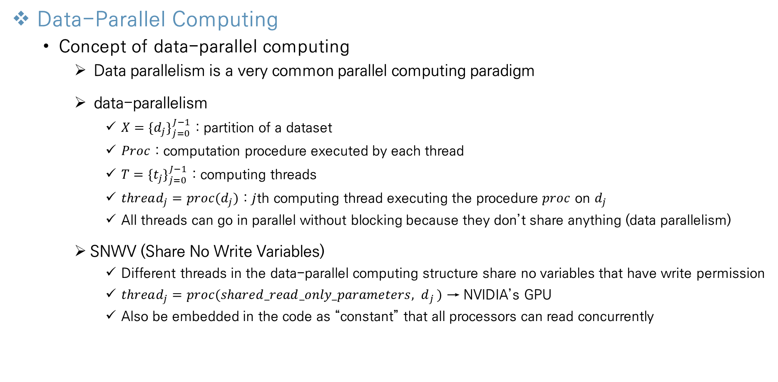
Uniformly Fine-Grained Data-Parallel Computing on a GPU
Data-Parallel Computing
Concept of data-parallel computing
Data parallelism is a very common parallel computing paradigm
data-parallelism
$X=\{d_{j}\}_{j=0}^{J−1}$ : partition of a dataset
$Proc$ : computation procedure executed by each thread
$T=\{t_{j}\}_{j=0}^{J−1}$ : computing threads
$thread_{j}=proc(d_{j})$ : $j$th computing thread executing the procedure $proc$ on $d_{j}$
All threads can go in parallel without blocking because they don’t share anything (data parallelism)
SNWV (Share No Write Variables)
Different threads in the data-parallel computing structure share no variables that have write permission
$thread_{j}=proc(shared_read_only_parameters{, d}_{j})$ → NVIDIA’s GPU
Also be embedded in the code as “constant” that all processors can read concurrently
Notes:
지금까지 gpu의 구조에 대한 설명이었고, 이제 data-parallel computing과 uniformly fine-grained data-parallel computing에 대해 설명해드리겠습니다.

Slide 11
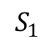
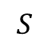
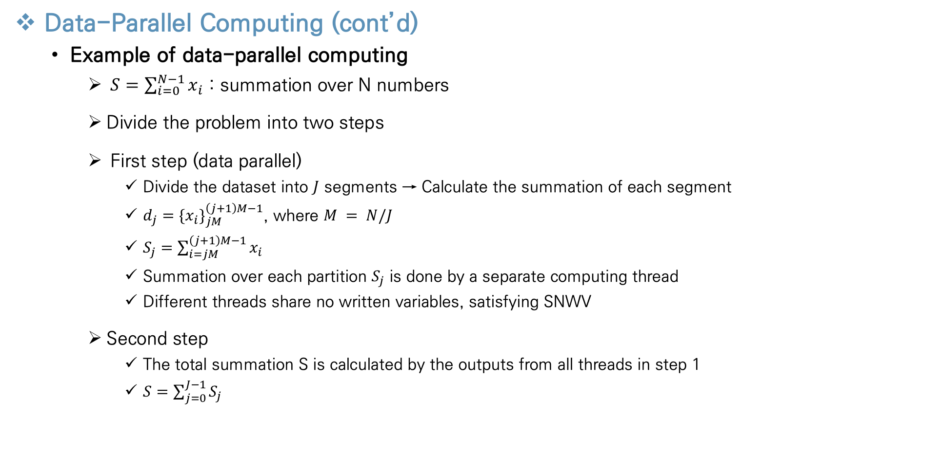
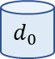
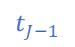
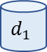
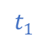
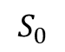

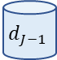
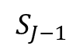
Uniformly Fine-Grained Data-Parallel Computing on a GPU
Data-Parallel Computing (cont’d)
Example of data-parallel computing
$S=\sum_{i=0}^{N−1}{x_{i}}$ : summation over N numbers
Divide the problem into two steps
First step (data parallel)
Divide the dataset into $J$ segments → Calculate the summation of each segment
$d_{j}=\{x_{i}\}_{jM}^{\left(j+1\right)M−1}$, where $M = N/J$
$S_{j}=\sum_{i=jM}^{\left(j+1\right)M−1}{x_{i}}$
Summation over each partition $S_{j}$ is done by a separate computing thread
Different threads share no written variables, satisfying SNWV
Second step
The total summation S is calculated by the outputs from all threads in step 1
$S=\sum_{j=0}^{J−1}{S_{j}}$
$$d_{0}$$
$$d_{1}$$
….
$$d_{J−1}$$
$$t_{0}$$
$$t_{1}$$
$$t_{J−1}$$
$$S_{0}$$
$$S_{1}$$
$$S_{J−1}$$
$$S$$
Notes:
이해를 돕기위해 간단한 예시를 들어 설명드리겠습니다

Slide 12
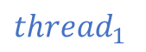
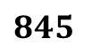
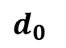

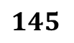
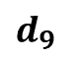
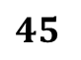
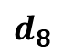
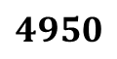

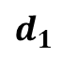

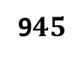
Uniformly Fine-Grained Data-Parallel Computing on a GPU
Data-Parallel Computing (cont’d)
Example of data-parallel computing
The number of thread(J) : 10
The number of data(N) : 100
0 1 2 … 97 98 99
$$d_{0}$$
$$d_{1}$$
$$d_{8}$$
$$d_{9}$$
0 1 2 … 7 8 9
10 11 … 18 19
…….
80 81 … 88 89
90 91 … 98 99
$${thread}_{0}$$
$${thread}_{1}$$
$${thread}_{8}$$
$${thread}_{9}$$
$$45$$
$$145$$
$$845$$
9$45$
$$4950$$
Notes:
다음은 앞의 예시를 그림으로 표현한것입니다

Slide 13
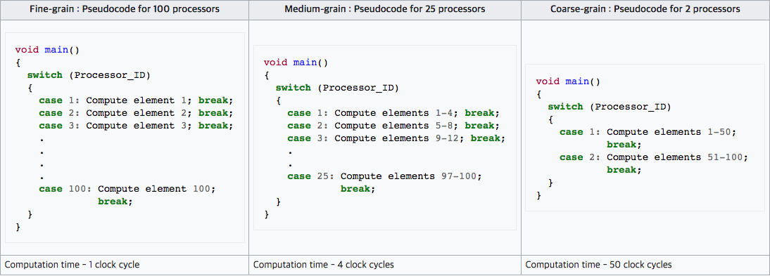
Uniformly Fine-Grained Data-Parallel Computing on a GPU
Uniformly Fine-Grained Data-Parallel Design
Concept of Uniformly Fine-Grained Data-Parallel Design
When all processors execute the same instruction, the highest utilization of the processors is achieved
Characterize the programs well suited for GPUs as uniformly fine-grained data-parallel algorithms
Uniformity
uniformity of instructions executed on the same multiprocessor
uniformity of data partitioning over the array of processor
Fine granularity
parallelization is implemented at the lowest level
Instructions are executed on the multiprocessors at the same
time while individual data access requests are made to the memory
This will hide the memory access latency better
Having long, separated data access phases and computation phases is not a good design
Notes:
Data parallel computing도 많은 성능 향상을 가져오지만 uniformly fine grained data parallel computing. 이 가능한경우 더 높은 서능 향상을 기대할 수있다

Slide 14
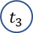
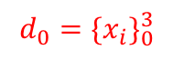

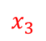
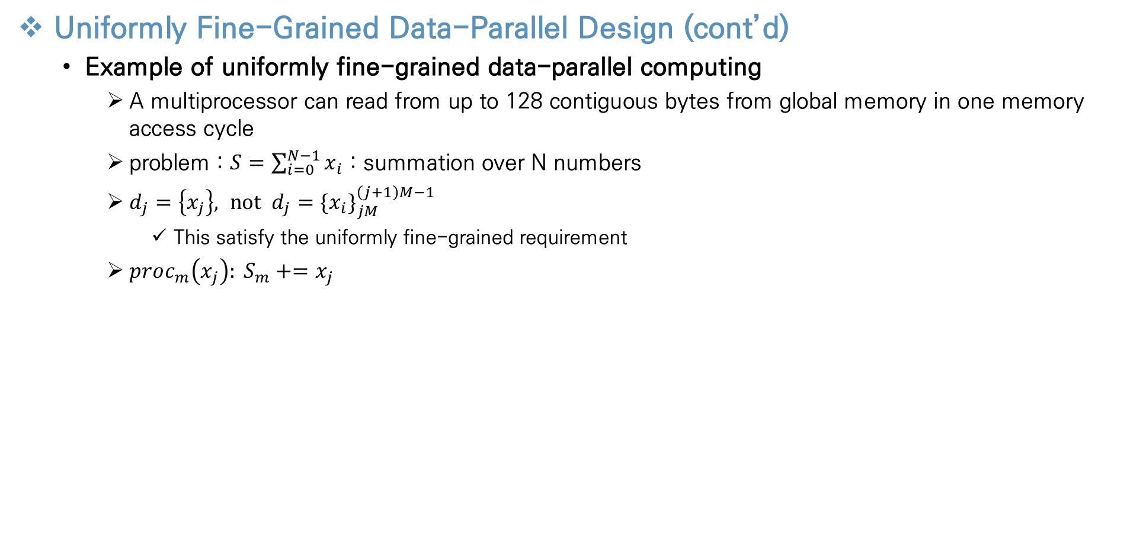




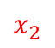
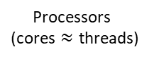

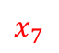


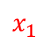
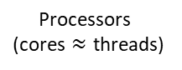

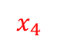
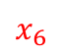




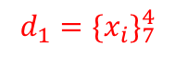
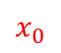
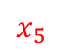
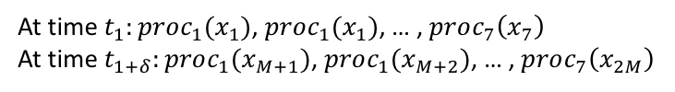
Uniformly Fine-Grained Data-Parallel Computing on a GPU
Uniformly Fine-Grained Data-Parallel Design (cont’d)
Example of uniformly fine-grained data-parallel computing
A multiprocessor can read from up to 128 contiguous bytes from global memory in one memory access cycle
problem : $S=\sum_{i=0}^{N−1}{x_{i}}$ : summation over N numbers
$d_{j}=\left\{x_{j}\right\}, not d_{j}=\{x_{i}\}_{jM}^{\left(j+1\right)M−1}$
This satisfy the uniformly fine-grained requirement
$proc_{m}\left(x_{j}\right): S_{m}+=x_{j}$
$$d_{0}=\{x_{i}\}_{0}^{3}$$
$$x_{0}$$
$$x_{1}$$
$$x_{2}$$
$$x_{3}$$
7
6
1 5
0 4
7
6
1 5
0 4
$$t_{0}$$
$$t_{1}$$
$$t_{2}$$
$$t_{3}$$
$$t_{0}$$
$$t_{1}$$
$$t_{2}$$
$$t_{3}$$
At time $t_{1}:proc_{1}(x_{1})$, $proc_{1}(x_{1})$, … , $proc_{7}\left(x_{7}\right)$
At time $t_{1+δ}:proc_{1}(x_{M+1})$, $proc_{1}(x_{M+2})$, … , $proc_{7}\left(x_{2M}\right)$
$$t_{4}$$
$$t_{5}$$
$$t_{6}$$
$$t_{7}$$
$$t_{4}$$
$$t_{5}$$
$$t_{6}$$
$$t_{7}$$
$$d_{1}=\{x_{i}\}_{7}^{4}$$
$$x_{4}$$
$$x_{5}$$
$$x_{6}$$
$$x_{7}$$
Cache
Processors
(cores $≈$ threads)
Cache
Processors
(cores $≈$ threads)
All processors are always busy & low memory access delay
Notes:
다음으로 앞에서 풀었던 예제를 uniformly fine-grained방법으로 푸는 방법입니다

Slide 15
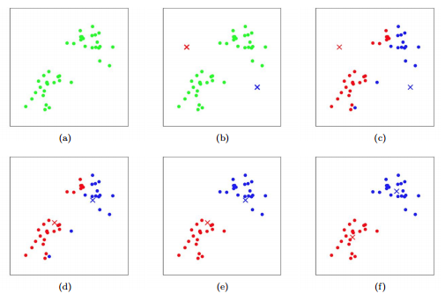
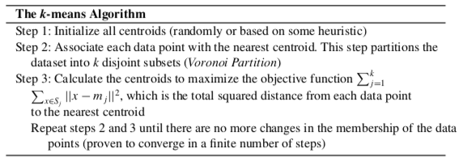


The k-Means Clustering Algorithm
Concept of k-Means Clustering Algorithm
Pseudocode
$X=\{x_{i}|i=1,…,N\}$ : dataset
$k$ : the number of cluster, $M=\left\{m_{j} | j=1,…,k\right\}$ : $k$ cluster centroids
$S_{j}⊂X$ : the subset of $x$ that are closer to $m_{j}$
This algorithm guarantees convergence to only a local optimum of the objective function
Notes:
지금까지 일반 data parallel과 uniformly fine-grained data parallel의 정의 및 차이점에 대해 설명드렸고 이제 실제 k mean 과 k mean regression clustering에서 어떻게 사요오디는지 설며으리겠습니다

Slide 16







The k-Means Clustering Algorithm
Data Parallelism in k-Means
Data-Parallel design
A dataset is partitioned into blocks with the number of data points matching the thread block size
The step 2 of k-Means data parallel and can be performed in an SNWV.
Each thread evaluates the distances from a data point to all the centroids (Parallel)
Each thread assigns the membership of the data points (Parallel)
The centroids are loaded to all the multiprocessors as read-only variables and shared (SNWV)
Membership vector calculated on the GPU is transferred to the CPU to update the centroids
$$thread_{b}$$
$$d_{0}$$
$$d_{1}$$
….
$$d_{J−1}$$
$$t_{0}\sim t_{a}$$
$$t_{a}\sim t_{b}$$
$$t_{a}\sim t_{J−1}$$
GPU
$$membership of data points$$
$$thread_{a}$$
CPU
Each thread calculates the distance
from a data to all the centroids
Centroids are shared by all the threads
(Read-Only variables)
Global centroids
Notes:
다음은 k mean에서 일반 data parallel 과정입니다

Slide 17



























The k-Means Clustering Algorithm
Fine-Grained Data-Parallelism in k-Means
Fine-Grained Data-Parallel design
Fine grained data-parallel computation is achieved by arranging the data values of all threads in a thread block to work in a synchronized fashion
The column of input datasets is naturally one datapoint
The input data should be arranged
The data points that are accessed by all threads in block in the same clock cycle are consecutive in memory
3 | 7 | 7 | 3 | 3 | 7 | 7 | 3
2 | 6 | 6 | 2 | 2 | 6 | 6 | 2
1 | 5 | 5 | 1 | 1 | 5 | 5 | 1
0 | 4 | 4 | 0 | 0 | 4 | 4 | 0
7
6
1 5
0 4
$$t_{0}$$
$$t_{1}$$
$$t_{2}$$
$$t_{3}$$
Data
Parallelism
$$t_{4}$$
$$t_{5}$$
$$t_{6}$$
$$t_{7}$$
$$d_{0}$$
$$d_{1}$$
$$d_{2}$$
$$d_{3}$$
$$d_{4}$$
$$d_{5}$$
$$d_{6}$$
$$d_{7}$$
Cache
Processors
(cores $≈$ threads)
3 | 7 | 7 | 3 | 3 | 7 | 7 | 3
2 | 6 | 6 | 2 | 2 | 6 | 6 | 2
1 | 5 | 5 | 1 | 1 | 5 | 5 | 1
0 | 4 | 4 | 0 | 0 | 4 | 4 | 0
7
7 3
3 7
7 3
Uniformly
Fine-Grained
Data-Parallelism
$$t_{0}$$
$$t_{1}$$
$$t_{2}$$
$$t_{3}$$
$$t_{4}$$
$$t_{5}$$
$$t_{6}$$
$$t_{7}$$
$$d_{0}$$
$$d_{1}$$
$$d_{2}$$
$$d_{3}$$
$$d_{4}$$
$$d_{5}$$
$$d_{6}$$
$$d_{7}$$
Cache
Processors
(cores $≈$ threads)
Notes:
다음은 k mean 을 uniformly fine 하게 실행하는 방법
메인 메모리 언급
1개 데이터의 모든 차원의 숫자들을 이용하여 거리를 구했다면
각 차원별로 거기를 구하여 합하도록 변경
그림에서 스레드가 하는일을 명시할 필요 있음

Slide 18


































The k-Means Clustering Algorithm
Fine-Grained Data-Parallelism in k-Means (cont’d)
Fine-Grained Data-Parallel design
Process of Coarse-Grained Data-Parallel
All running thread calculate the distance from the point(whole dimension) to centroids
3 | 7 | 7 | 3 | 3 | 7 | 7 | 3
2 | 6 | 6 | 2 | 2 | 6 | 6 | 2
1 | 5 | 5 | 1 | 1 | 5 | 5 | 1
0 | 4 | 4 | 0 | 0 | 4 | 4 | 0
7
6
1 5
0 4
3 | 7 | 7 | 3 | 3 | 7 | 7 | 3
2 | 6 | 6 | 2 | 2 | 6 | 6 | 2
1 | 5 | 5 | 1 | 1 | 5 | 5 | 1
0 | 4 | 4 | 0 | 0 | 4 | 4 | 0
7 3
6 2
5 1
4 0
$$t_{0}$$
$$t_{1}$$
$$t_{2}$$
$$t_{3}$$
$$t_{0}$$
$$t_{1}$$
$$t_{2}$$
$$t_{3}$$
$$t_{4}$$
$$t_{5}$$
$$t_{6}$$
$$t_{7}$$
$$t_{4}$$
$$t_{5}$$
$$t_{6}$$
$$t_{7}$$
$$d_{0}$$
$$d_{1}$$
$$d_{2}$$
$$d_{3}$$
$$d_{4}$$
$$d_{5}$$
$$d_{6}$$
$$d_{7}$$
Cache
Processors
(cores $≈$ threads)
$$d_{0}$$
$$d_{1}$$
$$d_{2}$$
$$d_{3}$$
$$d_{4}$$
$$d_{5}$$
$$d_{6}$$
$$d_{7}$$
Cache
Processors
(cores $≈$ threads)
3 | 7 | 7 | 3 | 3 | 7 | 7 | 3
2 | 6 | 6 | 2 | 2 | 6 | 6 | 2
1 | 5 | 5 | 1 | 1 | 5 | 5 | 1
0 | 4 | 4 | 0 | 0 | 4 | 4 | 0
7
2 6
1 5
0 4
3 | 7 | 7 | 3 | 3 | 7 | 7 | 3
2 | 6 | 6 | 2 | 2 | 6 | 6 | 2
1 | 5 | 5 | 1 | 1 | 5 | 5 | 1
0 | 4 | 4 | 0 | 0 | 4 | 4 | 0
7 3
6 2
5 1
4 0
$$t_{0}$$
$$t_{1}$$
$$t_{2}$$
$$t_{3}$$
$$t_{0}$$
$$t_{1}$$
$$t_{2}$$
$$t_{3}$$
$$t_{4}$$
$$t_{5}$$
$$t_{6}$$
$$t_{7}$$
$$t_{4}$$
$$t_{5}$$
$$t_{6}$$
$$t_{7}$$
$$d_{0}$$
$$d_{1}$$
$$d_{2}$$
$$d_{3}$$
$$d_{4}$$
$$d_{5}$$
$$d_{6}$$
$$d_{7}$$
Cache
Processors
(cores $≈$ threads)
$$d_{0}$$
$$d_{1}$$
$$d_{2}$$
$$d_{3}$$
$$d_{4}$$
$$d_{5}$$
$$d_{6}$$
$$d_{7}$$
Cache
Processors
(cores $≈$ threads)
Notes:
좀더 직관적인 이해를 위해 그림으로 표현

Slide 19















The k-Means Clustering Algorithm
Fine-Grained Data-Parallelism in k-Means (cont’d)
Fine-Grained Data-Parallel design
Process of Fine-Grained Data-Parallel
All running thread calculate the distance from the point(one dimension) to centroids
3 | 7 | 7 | 3 | 3 | 7 | 7 | 3
2 | 6 | 6 | 2 | 2 | 6 | 6 | 2
1 | 5 | 5 | 1 | 1 | 5 | 5 | 1
0 | 4 | 4 | 0 | 0 | 4 | 4 | 0
7
7 3
3 7
7 3
3 | 7 | 7 | 3 | 3 | 7 | 7 | 3
2 | 6 | 6 | 2 | 2 | 6 | 6 | 2
1 | 5 | 5 | 1 | 1 | 5 | 5 | 1
0 | 4 | 4 | 0 | 0 | 4 | 4 | 0
2 6
6 2
2 6
6 2
$$t_{0}$$
$$t_{1}$$
$$t_{2}$$
$$t_{3}$$
$$t_{0}$$
$$t_{1}$$
$$t_{2}$$
$$t_{3}$$
$$t_{4}$$
$$t_{5}$$
$$t_{6}$$
$$t_{7}$$
$$t_{4}$$
$$t_{5}$$
$$t_{6}$$
$$t_{7}$$
$$d_{0}$$
$$d_{1}$$
$$d_{2}$$
$$d_{3}$$
$$d_{4}$$
$$d_{5}$$
$$d_{6}$$
$$d_{7}$$
Cache
Processors
(cores $≈$ threads)
$$d_{0}$$
$$d_{1}$$
$$d_{2}$$
$$d_{3}$$
$$d_{4}$$
$$d_{5}$$
$$d_{6}$$
$$d_{7}$$
Cache
Processors
(cores $≈$ threads)
3 | 7 | 7 | 3 | 3 | 7 | 7 | 3
2 | 6 | 6 | 2 | 2 | 6 | 6 | 2
1 | 5 | 5 | 1 | 1 | 5 | 5 | 1
0 | 4 | 4 | 0 | 0 | 4 | 4 | 0
1 5
5 1
1 5
5 1
3 | 7 | 7 | 3 | 3 | 7 | 7 | 3
2 | 6 | 6 | 2 | 2 | 6 | 6 | 2
1 | 5 | 5 | 1 | 1 | 5 | 5 | 1
0 | 4 | 4 | 0 | 0 | 4 | 4 | 0
0 4
4 0
0 4
4 0
$$t_{0}$$
$$t_{1}$$
$$t_{2}$$
$$t_{3}$$
$$t_{0}$$
$$t_{1}$$
$$t_{2}$$
$$t_{3}$$
$$t_{4}$$
$$t_{5}$$
$$t_{6}$$
$$t_{7}$$
$$t_{4}$$
$$t_{5}$$
$$t_{6}$$
$$t_{7}$$
$$d_{0}$$
$$d_{1}$$
$$d_{2}$$
$$d_{3}$$
$$d_{4}$$
$$d_{5}$$
$$d_{6}$$
$$d_{7}$$
Cache
Processors
(cores $≈$ threads)
$$d_{0}$$
$$d_{1}$$
$$d_{2}$$
$$d_{3}$$
$$d_{4}$$
$$d_{5}$$
$$d_{6}$$
$$d_{7}$$
Cache
Processors
(cores $≈$ threads)
Notes:
Different data blocks are treated as “distributed datasets”

Slide 20
The k-Means Clustering Algorithm
Fine-Grained Data-Parallelism in k-Means (cont’d)
Fine-Grained vs Coarse-Grained
Coarse-Grained Data-Parallel
A lot of data is allocated to the thread at one time
Many processors are in idle
The latency of access to global memory is high
Fine-Grained Data-Parallel
A small amount of data is allocated to the thread at one time
Cache accesses global memory while all processors are working
Trade off the latency of access to global memory
The highest utilization of the processors is achieved
Notes:
Different data blocks are treated as “distributed datasets”

Slide 21



The k-Means Clustering Algorithm
Fine-Grained Data-Parallelism in k-Means (cont’d)
Fine-Grained Data-Parallel Pseudocode
Pseudocode for each thread to calculate the membership of the data points
It is called in each iteration of k-means
Input
$data\left[dimension\right]\left[index\right]$
$centroids\left[index\right]\left[dimension\right]$
$membership[index]$
$Parameters : data_size, num_dim$, $num_cluster$
Output : the membership vector
variables
Notes:
메인 메모리 언급

Slide 22

The k-Means Regression Clustering Algorithm
Concept of the k-Means Regression Clustering Algorithm
Regression Clustering(RC)
Regression clustering(RC) is a combination of clustering and regression
RC is performed in two steps
Clustering : the data points are assigned clustering labels
Regression : a regression function is fit to the data in each cluster
Each regression function of cluster is “cluster centroid”
Compared with the centroid-based k-means, the centroids in k-mean RC are more complex data models
When the dataset contains a mixture of very different response characteristics, regression is not effective
RC allows multiple regression function, each fitting part of the data
Notes:
다음은 rc 에 대한 설명입니다

Slide 23




The k-Means Regression Clustering Algorithm
Concept of the k-Means Regression Clustering Algorithm (cont’d)
The process of Regression Clustering(RC)
$k$ centroids → a set of regression functions $M=\left\{f_{1},…,f_{k}\right\}⊂φ$
RC-$k$-means has the following steps
Step 2
$e\left(f\left(x\right), y\right)={\left\|f\left(x\right)−y\right\|}^{2}$
Associate each data point with the nearest regression function and partition the dataset into $k$ partitions
Same with the calculate membership vector step in centroid-based k-means
Step 3
Maximize objective function
Notes:
모든 Feature마다 이상치를 제거하게 되면 너무 많은 데이터 손실이 발생

Slide 24



The k-Means Regression Clustering Algorithm
Fine-Grained Data-Parallel Structures in k-Means RC Algorithm
$k$-means RC also has two phases in each iteration
Membership calculation step
It is similar with membership calculation step in centroid-based k-means
Just two items are different
Calculate the distance from “point to point” to “point to function”
The centroids(regression function parameters) are loaded to all the multiprocessors as read-only variables and shared (SNWV)
$$thread_{b}$$
$$d_{0}$$
$$d_{1}$$
….
$$d_{J−1}$$
$$t_{0}\sim t_{a}$$
$$t_{a}\sim t_{b}$$
$$t_{a}\sim t_{J−1}$$
GPU
$$membership of data points$$
$$thread_{a}$$
GPU
Global centroids
Each thread calculates the distance
from a data to all the regression functions
functions are shared by all the threads
(Read-Only variables)
Notes:
K mean cluster에서는 steo2가 단순 점의 평균이기에 cpu에서 처리했으니 여기서는 regression 계산해야 하기 때문에 gpu 에서 처리하였다

Slide 25

The k-Means Regression Clustering Algorithm
Fine-Grained Data-Parallel Structures in k-Means RC Algorithm (cont’d)
Calculating the new center-functions step
assume that we are doing a simple multivariate linear regression
Regression function : $y=c_{j}^{T}x,$ $c :$coefficient of regression function in $j$th cluster
The data points in each cluster are used to update the center-function they are associated with by a MSE regression for the best fit to the data in the cluster
Calculate coefficient $c_{j}$
$L_{j}$ : the number of data points assigned into the $j$th cluster
$A_{j}$ : data vectors in the $j$th cluster, $B_{j}$: corresponding $y$-values
$A_{j}=\left[\begin{aligned}x_{1} \\ … \\ x_{L_{j}}\end{aligned}\right]$ , $b_{j}=\left[\begin{aligned}y_{1} \\ … \\ y_{L_{j}}\end{aligned}\right]$
When $A_{j}c_{j}$= $b_{j}$, we can calculate $c_{j}$ using normal equation $c_{j}=(A_{j}^{T}A_{j})^{−1}A_{j}^{T}b_{j}$
If dimension of $x$ is 5,
$A_{j}=\left[\begin{aligned}a b c d e \\ … \\ f g h i j\end{aligned}\right]$, $b_{j}=\left[\begin{aligned}a \\ … \\ b\end{aligned}\right]$, $c_{j}=$ $\left[\begin{aligned}a \\ b \\ c \\ d \\ e\end{aligned}\right]$
Notes:
모든 Feature마다 이상치를 제거하게 되면 너무 많은 데이터 손실이 발생

Slide 26















The k-Means Regression Clustering Algorithm
Fine-Grained Data-Parallel Structures in k-Means RC Algorithm (cont’d)
Calculating the new center-functions step
Calculate coefficient $c_{j}$ in parallel
$c_{j}=(A_{j}^{T}A_{j})^{−1}A_{j}^{T}b_{j}$
Rewrite the matrix multiplication and the vector multiplication as summations over the data points
These show the data-parallel structure of the computing tasks and work can be naturally partitioned by breaking up the summation over 1 to $L_{j}$
$$A_{j}^{T}A_{j}=\sum_{l=1}^{L_{j}}{x_{l}^{T}∗}x_{l}$$
$$A_{j}^{T}b_{j}=\sum_{l=1}^{L_{j}}{x_{l}^{T}∗}b_{j}$$
Data of cluster $j$
Chunk of data
Chunk of data
Same dimension values of datasets
3 | 7 | 7 | 3 | 3 | 7 | 7 | 3
2 | 6 | 6 | 2 | 2 | 6 | 6 | 2
1 | 5 | 5 | 1 | 1 | 5 | 5 | 1
0 | 4 | 4 | 0 | 0 | 4 | 4 | 0
$$A_{j}^{T}A_{j}=\sum_{l=1}^{L_{j}}{x_{l}^{T}∗}x_{l}$$
Chunk of data
Chunk of data
$$A_{j}^{T}b_{j}=\sum_{l=1}^{L_{j}}{x_{l}^{T}∗}b_{j}$$
Chunk of data
Chunk of data
Fine-grained computation
$$d_{0}$$
$$d_{1}$$
$$d_{2}$$
$$d_{3}$$
$$d_{4}$$
$$d_{5}$$
$$d_{6}$$
$$d_{7}$$
Notes:
모든 Feature마다 이상치를 제거하게 되면 너무 많은 데이터 손실이 발생

Slide 27


Implementations and Performance Comparisons
CPU-Only Implementation of $k$-Means
MineBench : high-performance multi-threaded data-mining package
Author’s own highly optimized $k$-means package
Author’s optimized CPU code for k-means runs several times faster than MineBench
Notes:
모든 Feature마다 이상치를 제거하게 되면 너무 많은 데이터 손실이 발생

Slide 28



Implementations and Performance Comparisons
GPU-Accelerated $k$-Means & $k$-Means clustering Algorithm
HPL CPU – author’s optimized CPU-only implementations
HPL GPU – author’s GPU-accelerated version
Achieved an average of 190x speedup over MineBench running on single core
Achieved a 49x speedup over author’s own optimized CPU implementations
Performance of K-means on GPU
Performance of K-means RC on GPU
Notes:
모든 Feature마다 이상치를 제거하게 되면 너무 많은 데이터 손실이 발생

Slide 29
Conclusions
Conclusions about this chapter
GP-GPU has advanced rapidly and has been applied to a variety of scientific computing algorithms
Uniformly Fine-Grained Data-Parallel computing paradigm has a high-performance parallel implementations of computing tasks on a GP-GPU
Not all algorithms fit well on a GPU, before programming an algorithm on a GPU, discovering uniformly fine-grained data parallelism in the algorithm is very important
GPU provides significant speedups for intensive numerical computing at relatively low hardware cost and energy cost
Notes:
모든 Feature마다 이상치를 제거하게 되면 너무 많은 데이터 손실이 발생

Slide 30
Thank You!

